Slide 1

Chapter 3
Design Theory for Relational Databases

Slide 2
OBJECTIVES
Understand concepts of:
Functional Dependencies (Phụ thuộc hàm)
Normalization (Chuẩn hoá lược đồ CSDL)
Decomposition (Phân rã lược đồ CSDL)
Multi-valued Dependencies (Phụ thuộc hàm đa trị)

Slide 3
CONTENT
Functional Dependencies
Rules about FDs
Key & Super-Key
Normal forms

Slide 4
I.
Functional
Dependencies

Slide 5
3.1. Functional dependencIES (FDs)
Functional dependencies (FDs)
A functional dependency: constraint between two sets of attributes in a relation (describe relationship among attributes in a relation)
X (include A₁A₂…A_{n}): a set of attributes in R
Y (include B₁B₂…B_{m}): another set of attribute in R

Slide 6
3.1. Functional dependency (FD)
We write X→Y (read as X determines Y or Y is functionally dependent on X) if and only if each X value is associated with precisely one Y value.
Means given a value of X, we can find one and exactly one value of Y

Slide 7
Examples 1
Student
sId | sName | sDoB
1 | John Smith | 1999-01-12
2 | Remesh Shah | 1998-02-28
3 | Susan Black | 1999-08-10
4 | John Smith | 1999-01-12
5 | John Doe | 1998-02-28
Functional dependencies:
sId → {sName, sDob}
sName → sDoB

Slide 8
title | year | length | genre | studioName | star Name
Star Wars | 1977 | 124 | SciFi | Fox | Carrie Fisher
Star Wars | 1977 | 124 | SciFi | Fox | Hark Hamill
Star Vars | 1977 | 124 | SciFi | Fox | Harrison Ford
Gone With the Wind | 1939 | 231 | drama | MGM | Vivien Leigh
Wayne's World | 1992 | 95 | comedy | Paramount | Dana Carvey
Wayne'a World | 1992 | 95 | comedy | Paramount | Hike Meyers
Easy to see that: the following FD is true
title,year → length, genre, studioName
Exercise: How about the FD
title,year → starName ???
title, year → startName does not hold in Movies1 relation
Notes:
Give Movie relation, answer below questions:
1. What are the keys of relation?
2. What if we ignore the column starName?
3. Can starName be a key?
Easy to see that: the following FD is true
title,year → length, genre, studioName
Exercise: How about the FD
title,year → starName
title, year → startName does not hold in Movies1 relation

Slide 9

Identifying Functional Dependencies
Find the FDs in the relation below:
Notes:
Give Movie relation, answer below questions:
1. What are the keys of relation?
2. What if we ignore the column starName?
3. Can starName be a key?
Easy to see that: the following FD is true
title,year → length, genre, studioName
Exercise: How about the FD
title,year → starName
title, year → startName does not hold in Movies1 relation

Slide 10
Identifying Functional Dependencies
FD1: carReg -> make, model, outletNo, outletLoc
FD2: custNo -> custName
FD3: outletNo -> outletLoc
FD4: model -> make (only if we assume a model name is unique to a make)
FD5: carReg, hireDate -> make, model, custNo, custName, outletNo, outletLoc
...
Notes:
Give Movie relation, answer below questions:
1. What are the keys of relation?
2. What if we ignore the column starName?
3. Can starName be a key?
Easy to see that: the following FD is true
title,year → length, genre, studioName
Exercise: How about the FD
title,year → starName
title, year → startName does not hold in Movies1 relation

Slide 11
key & supper key

Slide 12
KEY of relation
Key
It has no duplicate values, it has unique values.
It cannot be NULL.
It can identify only one tuple (a record) at a time.
Primary keys are not necessarily to be a single column; more than one column can also be a primary key for a table.

Slide 13
SUPPER KEY
Review key of relation, candidate keys (alternate keys), primary key, Super-key
Super-key: A set of attributes that contains a key is called a super-key.
Every super-key satisfies the first condition of a key: it functionally determines all other attributes of the relation
If K is a key, L is a super key, then: K ⊆ L
A key is also a super key

Slide 14
3.2.
Rules about FDs

Slide 15
3. Rules about FDs
1. Armstrong’s Axioms (Hệ tiên đề Armstrong)
2. The Closure of Attributes (Bao đóng của tập thuộc tính)
3. Closing Sets of FDs & minimal basic (Bao đóng của tập phụ thuộc hàm & phủ tối thiểu (phụ thuộc hàm tối thiểu))
4. Projecting FDs
5. Anomalies introduction

Slide 16
3.1. Armstrong’s Axioms

Slide 17
3.1. Armstrong’s Axioms
A.Fundamental Rules: Let X, Y, Z are sets of attributes
Reflexivity (Luật phản xạ):
If X is a subset of Y, then Y→X
Augmentation (Luật thêm/tăng cường)
If X→Y, then XZ→YZ for any Z
Transitivity (Luật bắc cầu)
If X→Y and Y→Z, then X→Z

Slide 18
3.1. Armstrong’s Axioms
B. Additional rules (Các luật mở rộng): Let X, Y, Z, W are sets of attributes
Union/Combining (Luật hợp):
if X→Y AND X→Z then X→YZ
Decomposition/Splitting (Luật tách):
if X→YZ, then X→Y and X→Z

Slide 19
3.1. Armstrong’s Axioms
B. Additional rules (Các luật mở rộng): Let X, Y, Z, W are sets of attributes
Pseudotransitivity (Luật giả bắc cầu):
If X → Y and WY → Z then WX →Z
C. Trivial FDs (Các phụ thuộc hàm tầm thường): right side is a subset of left side
Ex: FLD →FD

Slide 20
3.1. Armstrong’s Axioms
A set of FD’s S follows (suy dẫn) from a set of FD’s T if every relation instance that satisfies all the FD’s in T also satisfies all the FD’s in S
Two sets of FD’s S and T are equivalent if and only if S follows from T, and T follows S

Slide 21
3.2. The Closure of Attributes

Slide 22
3.2. The Closure of Attributes
The closure of a set of attributes {A₁, A₂, …, A_{n}} (bao đóng của tập thuộc tính) under FD’s in S (denoted {A₁, A₂, …, A_{n}}⁺)_{F} is the set of attributes B such that every relation that satisfies all the FD’s in set S also satisfies A₁A₂…A_{n}→ B
That is, A₁A₂…A_{n}→ B follows from the FD’s of S
A₁, A₂, …, A_{n} ∈ {A₁, A₂, …, A_{n}}+, because A₁A₂…A_{n}→A_{i} is trivial

Slide 23
3.2. The Closure of Attributes
Algorithm 3.7: Closure of a set of attributes
Input: A set of attributes {A₁,A₂,…,A_{n}} and a set of FD’s S
Output: The closure {A₁,A₂,…,A_{n}}⁺
If necessary, split the FD’s of S, so each FD in S have singleton right side
Let X be a set of attributes that will become the closure. Initialize X to be {A₁,A₂,…,A_{n}}
Repeatedly search for some FD: B₁B₂…B_{m} → C, such that B₁, B₂, …, B_{m} are in X, but C is not
If such C is found, add to X, and repeat the search
If such C is not found, no more attributes can be added to X
The set X is the correct value of {A₁, A₂, …, A_{n}}+

Slide 24

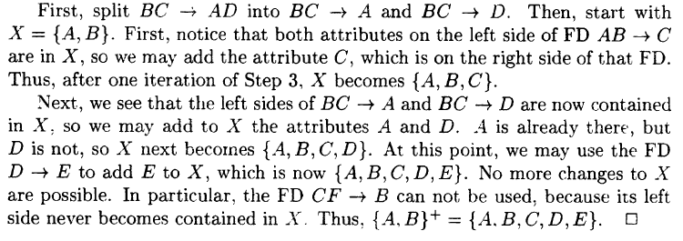
Compute the Closure of Attributes

Slide 25
Compute the Closure of Attributes
EX1:
R(A, B, C, D)
F = {A→B, B→C, C→D, D→A}
Compute A⁺_{F} , B⁺_{F} , BD⁺_{F.}
What are some the keys of R?

Slide 26
Compute the Closure of Attributes
Solution:
R(A, B, C, D)
F = {A→B, B→C, C→D, D→A}
A⁺_{F} = ABCD = R⁺ (a key of R)
B⁺_{S} = BCDA = R⁺ (a key of R)
BD⁺_{S} ⁼ BDAC = R⁺ (a supperkey of R)

Slide 27
Compute the Closure of Attributes
EX2:
Q(ABCDEGH),
F = {B→A, DA→CE, D→ H, GH→ C,AC→ D }
Compute A⁺_{F} ,ABC⁺_{F} DB⁺_{F,} BG⁺_{F}
What are some the keys of R?

Slide 28
3.3. Closing Sets of FDs & minimal basic

Slide 29
3.3. Closing Sets of FDs
Suppose a set of FD’s S, any set of FD’s T equivalent to S is said to be a basis for S. Then we say T is a basis for S
Just work with only FD’s that have singleton right sides
A minimal basis (minimal cover) for FD’s S is a basis B that satisfies three conditions:
All the FD’s in B have singleton right sides
If any FD is removed from B, the result is no longer a basis
If for any FD in B we remove one or more attributes from the left side, the result is no longer a basis

Slide 30
Steps to Find Minimal Cover
1. Split the right-hand attributes of all FDs.
Example: A->XY => A->X, A->Y
2. Remove Redundant Attributes:
For each FD, check if any attribute can be removed without changing the implied FD. If so, remove it.
3. Remove Redundant FDs:
For each FD, check if it can be implied by other FDs in the set. If so, remove it.

Slide 31
3.3. Closing Sets of FDs
Example:
R(A,B,C,D)
F = {AB→CD, B→C, C→ D}
Find minimal basis:
Step 1: F1 = {AB→C, AB→D, B→C, C→ D}
Step 2: F2 = {B→D, B→C, C→ D}
Step 3: F3 = {B→C, C→ D}

Slide 32
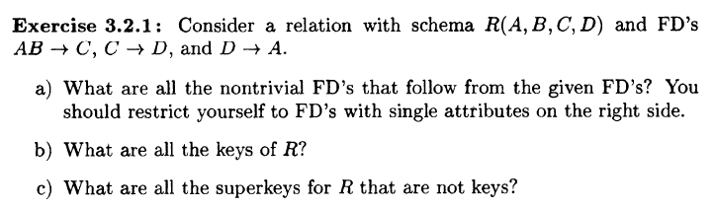
EXERCISE

Slide 33
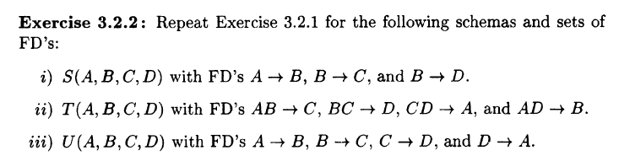
EXERCISE

Slide 34
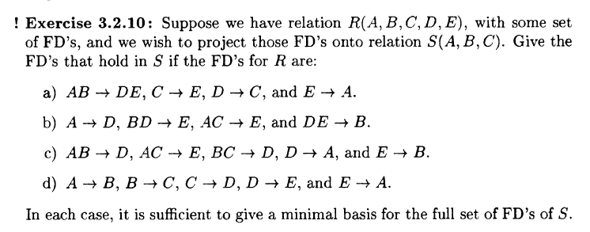
EXERCISE

Slide 35
3.4. Projecting FDs

Slide 36
What happens to …
… a set of FD’s S of R when we project R on some attributes?
That is, suppose a relation R with set of FD’s S, and R₁=π_{L}(R). What FD’s hold in R₁?

Slide 37
3.4. Projecting FDs
To find a FDs of projection, we
Follow from S, and
Involve only attributes of R₁

Slide 38
3.4. Projecting FDs
Algorithm 3.12: Projecting a Set of FD’s
Input: R, R₁=π_{L}(R), S a set of FD’s that hold in R
Output: the set of FD’s that hold in R₁
Method:
T is the set of FD’s that hold in R₁. Initially, T is empty
For each set of attributes X of R₁, compute X+. Add to T all non-trivial FD’s X → A such that A is both in X+ and an attribute of R₁
Construct a minimal basis from T

Slide 39
3.4. Projecting FDs
Algorithm 3.12: Projecting a Set of FD’s
Compute a minimal basis from T
If there is an FD F in T that follows from other FD’s in T, then remove F from T
Let Y → B is a FD in T , with at least two attributes in Y, and let Z is Y with one of its attributes removed:
If Z → B follows from the other FD’s in T (including Y → B), then replace Y → B by Z → B
Repeat the above steps in all possible ways until no more changes to T can be made

Slide 40
3.4. Projecting FDs
Two notations
(1) Closing the empty set and the set of all attributes cannot yield a nontrivial FD.
(2) If we have already knew that the closure of some set X is all attributes, then we cannot discover any new FD’s by closing supersets of X

Slide 41
3.4. Projecting FDs
Example:
R (A,B,C,D)
F = {A→B, B→C, C→D}
R1 = π_{A,C,D}(R).
Find the FD’s of R1?

Slide 42
3.4. Projecting FDs
Step1: Compute the closure of the singleton set
A⁺ = {A,B,C,D}, and B is not in R1, then new FD’s A→C, A→D
C⁺={C,D}, then new FD’s C→D
D⁺={D}, no new FD’s

Slide 43
3.4. Projecting FDs
Step2: Compute the closure of the doubleton set
Since {A}+ include all attributes, no care any more for supersets of {A}
{C,D}+={C,D}, no new FD’s holds in R1
Finally, there are three FD’s A→C, A→D, C→D hold in R1
A→D is transitive from A→C, and C→D
So, minimal basis is {A→C, C→D}

Slide 44
3.5. Anomalies introduction

Slide 45
3.5. Anomalies introduction
Careless selection of a relational database schema can lead to redundancy and related anomalies
So, in this session we shall tackle the problems of relational database designing
Problems such as redundancy that occur when we try to cram too much into a single relation are called anomalies.

Slide 46
3.5. Anomalies introduction
Redundancy?
Update Anomalies?
Deletion Anomalies

Slide 47
3.5. Anomalies introduction
The principal kinds of anomalies that we encounter are:
Redundancy: information maybe repeated unnecessarily in several tuples (exp: the length and genre)
Update Anomalies: We may change information in one tuple but leave the same information unchanged in another. (exp: if we found that Star Wars is 125 minutes long, we may change the length in the first tuple but not in the second and third tuples)
Deletion Anomalies: If a set of values becomes empty, we may lose other information as a side effect. (exp: if we delete “Fox” from the set of studios, then we have no more studios for the movie “Star Wars”

Slide 48
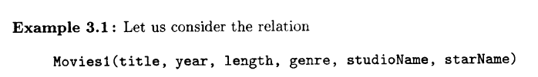
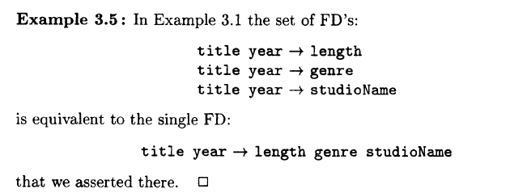
REVIEW 01

Slide 49
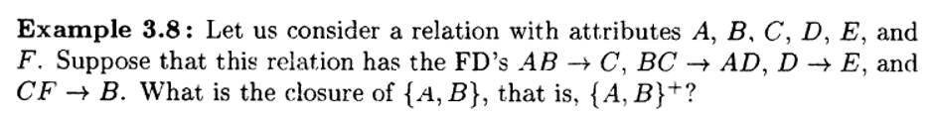
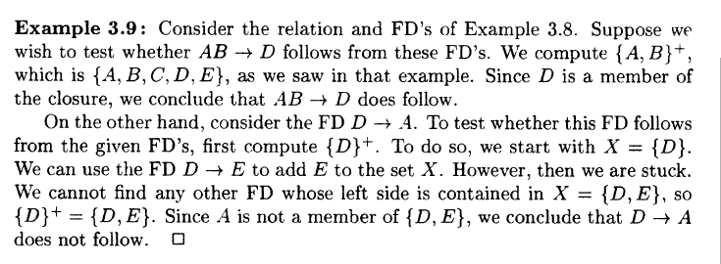
REVIEW 02

Slide 50
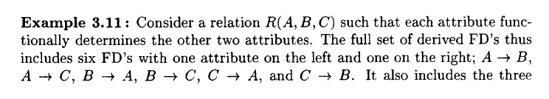
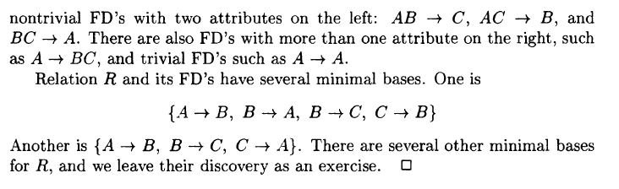
REVIEW 03

